Slide 1
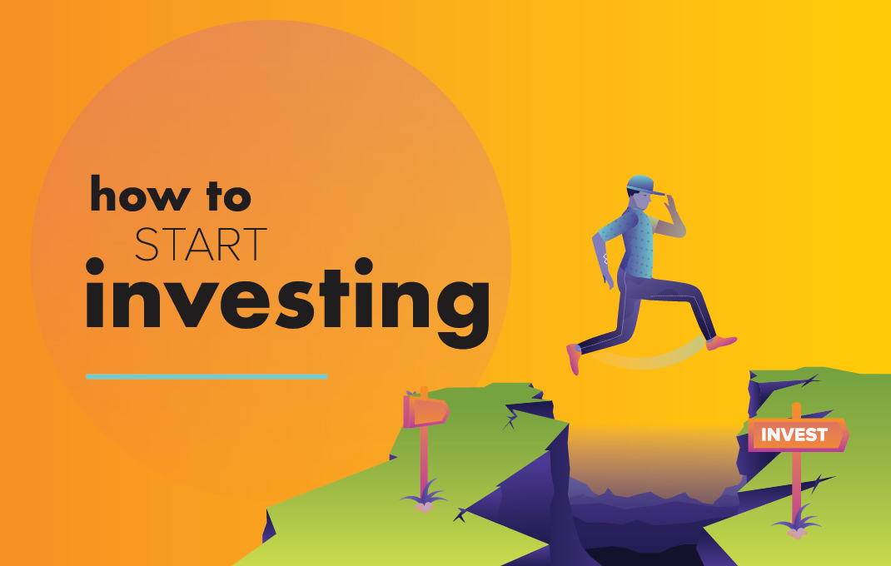
Financial Literacy
Investing
Booklet to accompany https://docs.google.com/document/d/1wLZ8qefbvs-oAy7H7-eQrUUVE6E_UJtBRK9j5ANpLdA/edit?usp=sharing
Notes:
Unit Plan https://docs.google.com/document/d/1ATH02Fz6cuA_HiIiz8wcuRoDNsioOEIqe7lKAxt9dMc/edit

Slide 2
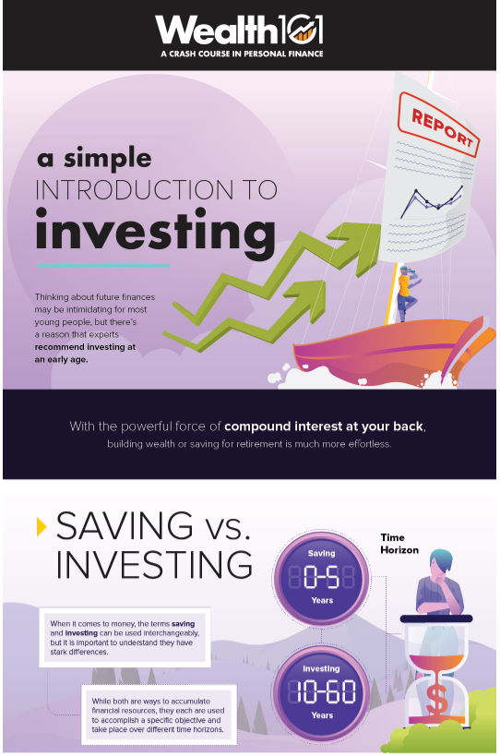
Why Invest?
In this infographic, we clarify the difference between saving and investing, and give some basic tips on how to get started in the market. https://wealth.visualcapitalist.com/simple-introduction-investing/
COMPOUND INTEREST https://youtu.be/wf91rEGw88Q

Slide 3
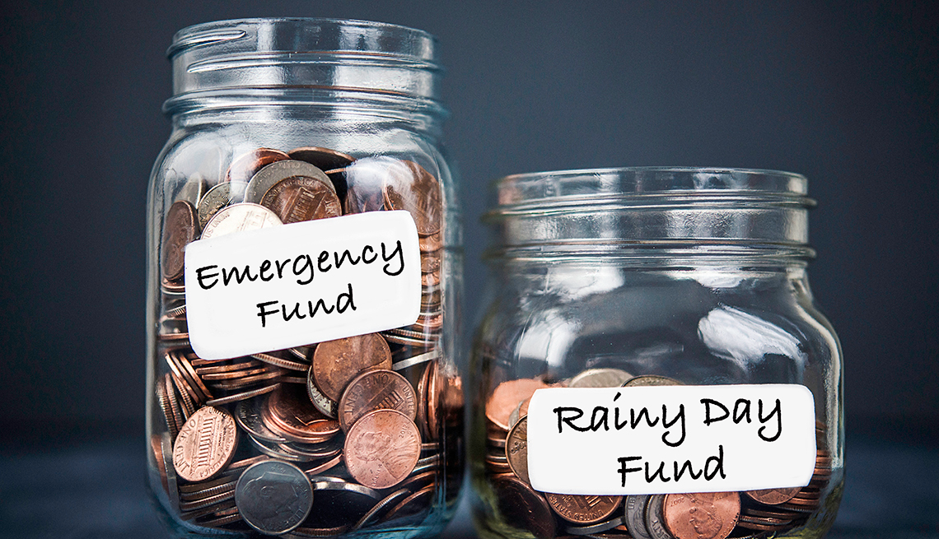
Short Term Savings
-“Emergency Funds” -Designed to cover everything from a car breakdown, a surprise visit to the emergency room, or a lost job. -While short term savings (emergency funds) often start out small, the recommended amount varies. -How much should you have? -$1500 to $4,000 -Others suggest at least 3 months’ worth of “operating expenses” (the money you spend each month on necessities – in case of job loss or medical leave)
-You need this money to be accessible (not locked away)

Slide 4
Long Term Savings
-Definition varies depending on what you are saving for. -Common is a retirement fund – but you can also save over the long term for large items such as wedding, cars, housing or vacations. -Key to success = keep it separate from your short term savings or emergency fund. Should not be easy for you to access – which will keep you from dipping into it for short term purchases.

Slide 5
Are Canadians saving enough?
The historic rate of saving in Canada is 7.61%. The average Canadian makes around $50,000/year, that would be savings of $3,805. The historical rate of 7.61% is still well below the recommended rate of 10%.
Unfortunately, however, Canadian households aren’t even coming close to attaining the historical rate in 2019. How much do Canadians save?
According to TradingEconomics.com (2019) the current savings rate for Canadians is 1.7% of household income in the second quarter of 2019. Assuming the same income of $50,000, that is only $850 saved every year. Why are Canadians so bad at saving?
(See Speaker Notes)
Notes:
Why Do Canadians Suck at Saving
https://forbeswealthblog.ca/2019/09/canadians-lack-personal-savings/ There are many reasons why Canadians suck at saving. Spending beyond our means, high cost of living to list a few, but the one we want to focus on is lack of communication. This lack of communication starts when we are kids.
Ideally our financial education should start when we are children. We should be taught how to save properly and how to spend properly (stay tuned for a future blog post about how to spend your money). However, that is not the case for most of us.
Money seems to be a taboo subject in most households. Typically minimal information is shared and everyone is left to figure it out for themselves.
A lot of our financial habits are generated by watching what our parents have done. For millennial’s, this may include observing our parents as home owners, RV or cabin owners, and and annual vacationers. Often times we do not observe the savings, budgeting or ‘behind the scenes’ activities that successful people are participating in.
This creates a false view of what healthy financial situations look like. After observing, we take those unhealthy habits into our adult years and into our own marriages. It may take years to figure out what a healthy financial situation actually looks like. By that point it might be too late.

Slide 6
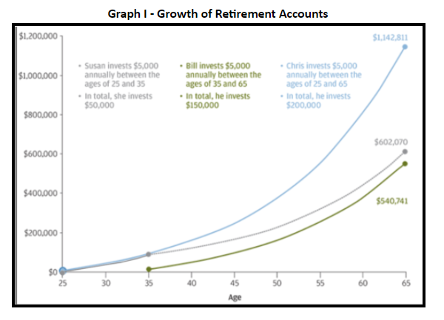
Who has the most money at age 65?
Retirement is ONE goal of investing.

Slide 8
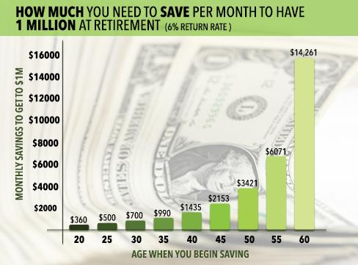
Why might some 20-year-olds have difficulty investing $360 per month for retirement?

Slide 9
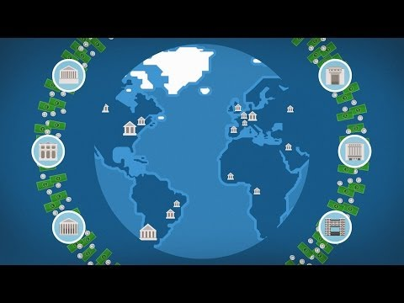
How does the Stock Exchange Work?
Be ready to answer 3 multiple choice questions on the next slide.
:) https://youtu.be/JrGp4ofULzQ

Slide 10
How does the Stock Exchange Work?
If the price of the share grows as the company grows, how does buying shares in a company benefit an investor?
An investor will be able to sell these shares for a lower price and make a profit.
An investor will be able to sell these shares for a higher price and make a profit.
An investor will be able to enjoy free services from the company they bought shares from.
An investor will be able to put the company on their resume.
How does selling shares on the stock exchange benefit companies?
They rely on a low return when selling shares.
They are immune to any volatility in the stock exchange when they sell their shares.
They receive funds to further expand their company.
They get more customers than when they did not sell shares.
As an investor, what is the risk involved when investing in companies on the stock exchange?
Investors can lose their existing shares if the value of the stock does not increase within 90 days of purchase
Once they purchase a share, investors cannot sell them at a higher price
The price of stocks can decrease; for example, when the company receives bad press
Investors are only at risk if the purchase a share when the stock price has fallen

Slide 11
QUESTION OF THE DAY
Investing
Q:
This company, whose product was being used by millions of students every day, has seen its stock price rise by more than 700% in 2020. Can you name it?
View blog post

Slide 12
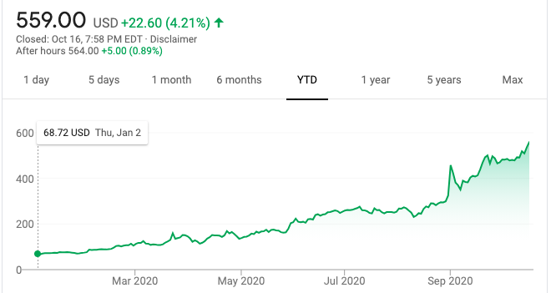
QUESTION OF THE DAY
Investing
A:
Zoom
Look at the stock price on October 2020 $559/share

Slide 13
FOLLOW-UP QUESTIONS
Do you currently use Zoom? Had you heard of Zoom pre-pandemic?
How do you think Zoom's business will do post-pandemic?
Will two of their larger sectors, education and business, return to more in-person interactions reducing their reliance on a product like Zoom?

Slide 14
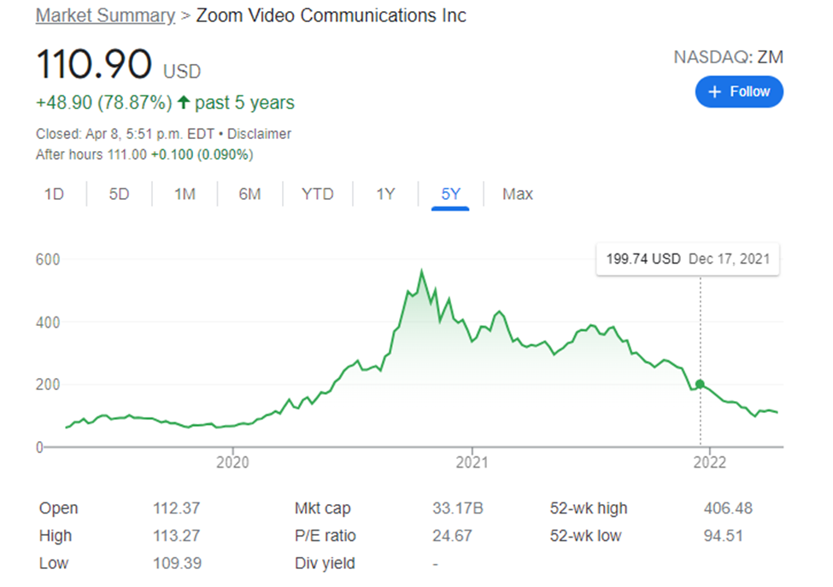
ZOOM stock price rose sharply - October 2020 $559/share to $110.90/share April 2022
… but it has been falling lately due to less usage…
Look at the 52 week high $406.48 and the 52 week low $94.51

Slide 15
Notes:
Risk you’re willing to take might depend on your goals

Slide 16
Notes:
Cash - totally liquid, but if you hold it in your wallet, it is actually going to LOSE value as inflation builds Some saving accounts are 0.04%. That is SO safe and SO low return. Not best way to build wealth.

Slide 17
Investing Basics: BONDS
When investing, some say it’s a good idea to have a mix of stocks and bonds in your portfolio. Watch this video to learn more about what bonds are and answer the questions.
What is a bond? How you would make money from it.
Why is it a good idea to invest in both bonds and stocks?
What is the risk you are taking when investing in bonds? How can you minimize this risk?
Why does the value of your bond decrease when interest rates increase?

Slide 19
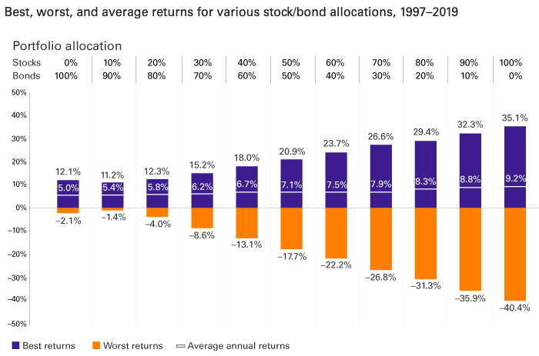
Data Crunch
https://docs.google.com/document/d/1bmtuXjPisZyJTETc0bDOieVlAh9_vP1p3dhEF3aMnOs/edit?usp=sharing
(key https://docs.google.com/document/d/1wLZ8qefbvs-oAy7H7-eQrUUVE6E_UJtBRK9j5ANpLdA/edit?usp=sharing )
See the above Doc for questions that go with this →

Slide 20
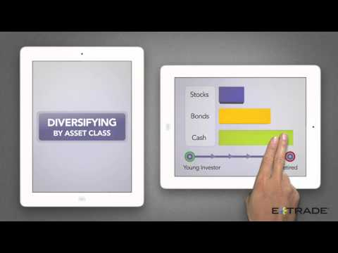
Diversification
One of the main benefits of investing in a fund, rather than in individual stocks and bonds, is diversification, or the spreading of risk. Watch this short video through 2:19 to learn more. Then, answer the questions.
What is meant by “asset allocation?”
Once you’ve done asset allocation, what’s the next level of diversification you should do among each asset class?
How does diversification protect investors?

Slide 21
STOP HERE AND COMPLETE BOOKLET
https://docs.google.com/document/d/1wLZ8qefbvs-oAy7H7-eQrUUVE6E_UJtBRK9j5ANpLdA/edit?usp=sharing

Slide 22
Stock Performance
Now that you know what it means to own individual stocks, let’s see how some popular stocks are doing in the market (use Yahoo Finance or Google Finance) Amazon Nike Snap Inc.
Each company has an abbreviated name called a ticker symbol. What is the ticker for each of these companies?
Which of these stocks has seen a significant rise in stock price in the past year? Which ones have stayed about the same? Have any decreased in price?
Look at the 5-year performance of Amazon. What do you think explains the general upward trend of the stock price?

Slide 23
Question Time
Notes:
Bonds: https://docs.google.com/document/d/10MfxTKKUh5-PFsf0QIykhnjwHY81yWgVCFumrvCl5gs/edit#

Slide 24
Invest that Latte!
Everyone has things they crave. Some people must always have a stick of gum on hand. Others need chapstick. Coffee is a daily ritual for many of us. On their own, all of these are relatively small purchases. However, over the course of a month or a year those expenses will add up to a LOT of money. What if, instead of spending small amounts on a regular basis, you saved that money and invested it for retirement? How much money would you have in 30 years?
Item I’m Forgoing | Price
NOTE - This should be something you can avoid without pain. Foregoing “lunch” does not count because everyone needs to eat lunch. However, if you always get a smoothie with your lunch, you could choose to forego the smoothie because you can remove it from your daily diet without hurting yourself. Item:
Calculate cost of this item for a full year. Assume you spend this amount 15 days a month for all 12 months. | Cost= Price x 15 x 12
http://www.bankrate.com/calculators/retirement/roi-calculator.aspx
https://docs.google.com/document/d/1TrWaORd2mQSakiVnG8K0VuzrgvXUKMZ8SzZ3ybGyB_s/edit?usp=sharing

Slide 25
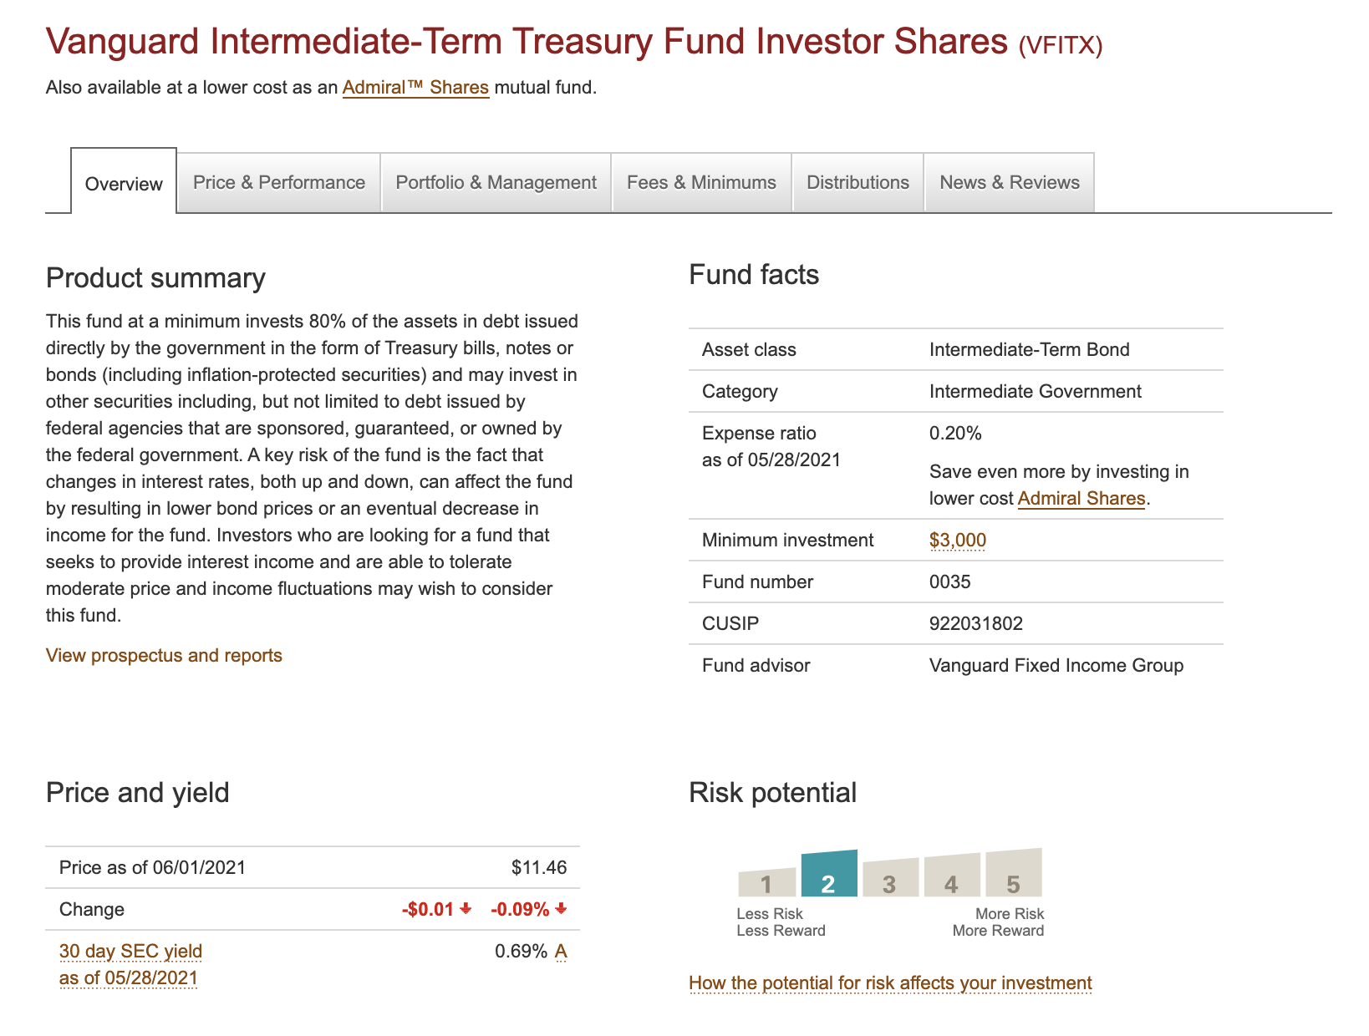
Activity: Analysing a Bond Mutual Fund Fact Sheet
https://docs.google.com/document/d/1KLPaX7DsQLUpRaLM2TsZHJYowvFjH48ZlWls8Pv-6B0/edit?usp=sharing
Read the fact sheets & answer the multiple choice questions. →

Slide 26
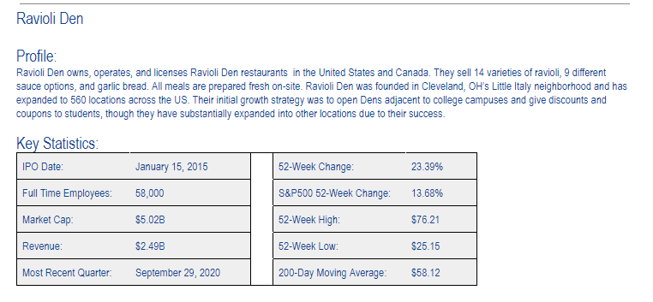
Project - Joining the Market
https://docs.google.com/document/d/1nY3s7iGDJ2-TwxGYpKQN1lE4e-0r5rInm8W3rUsR8Ko/edit?usp=sharing
Notes:
https://docs.google.com/document/d/130kkySnSGd2Rx999IKmBS7CwhtNn20v-EcGEIJNFjgA/edit#

Slide 27
RRSP & TFSA
What is an RRSP? --An RRSP is a retirement savings plan. --Deductible RRSP contributions can be used to reduce your tax. --An RRSP is like a basket that you can hold many different types of investments - stocks, bonds, GICs, etc. --Any income you earn in the RRSP is usually exempt from tax as long as the funds remain in the plan; you generally have to pay tax when you receive payments from the plan.
--Keep & earn money TAX FREE….for now. When you take the money out THEN you pay taxes on it.

Slide 28
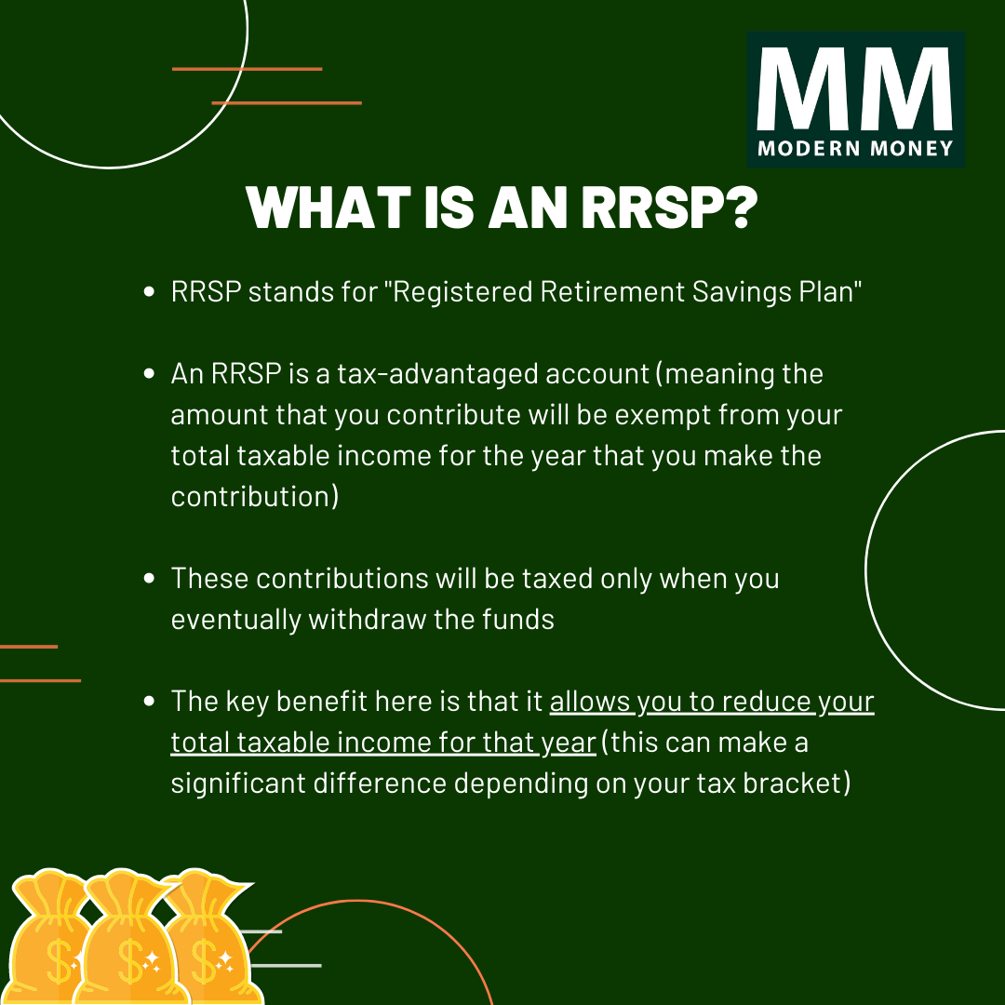

Slide 29
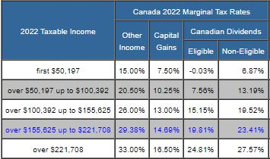
Investment Options: RRSP & TFSA
← example of deductions @ 5.59

Slide 30
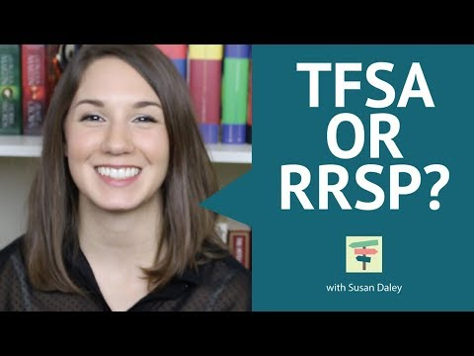
Investment Options: RRSP & TFSA

Slide 31
Investment Options: RRSP & TFSA

Slide 32
Guest Speakers: Investment Specialists from Conexus
Tuesday, Nov 30 @ 8.40am

Slide 33
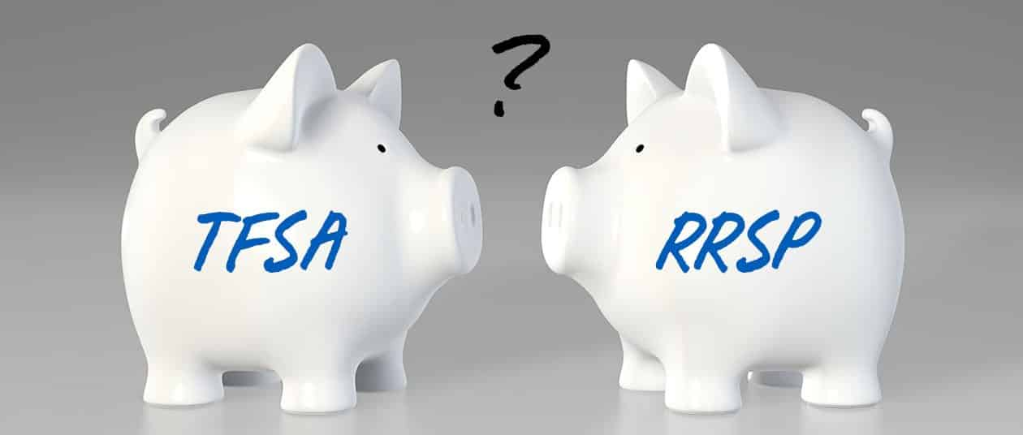

Slide 34
Let’s Learn More?
Your task: a) Read 1 article b) Summarize it in 5-10 points, c) Which would YOU invest your money in right now (or as soon as you turn 18)? •TD: TFSA vs. RRSP: What’s the Difference?
•Money Sense - TFSA vs RRSP Decision
•Wealth Simple - TFSA vs RRSP (Jan 2021)

Slide 35
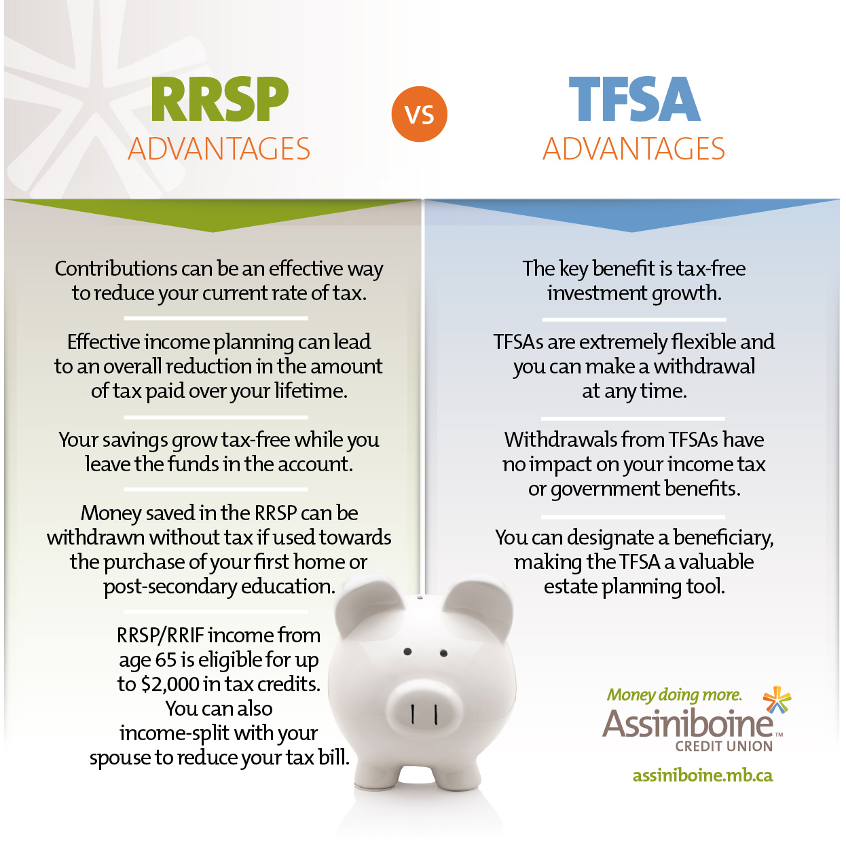

Slide 37
Raging Bull
Bull vs Bear Market?
Bull horns point UP = marketing is going UP
Bear swipes DOWN = bad times in the market

Slide 38
What if I don’t want individual stocks?
Rather than picking individual stocks and bonds, you can invest your money in funds that include a collection of stocks and bonds .
What do you think are the benefits of doing so?

Slide 39
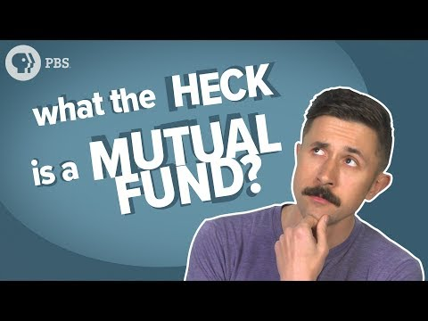
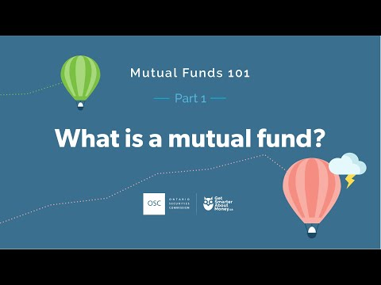
What is a Mutual Fund?
Edpuzzle with Miss Be Helpful: https://edpuzzle.com/media/5d34fa1b00a86b40bc876193

Slide 40
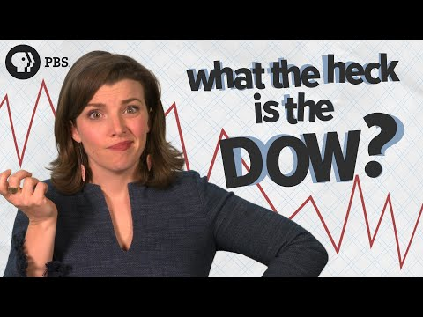
Activity: MOVE Let’s Make a Mutual Fund
Student Worksheet: https://docs.google.com/document/d/1z6b6yv4M0x5lmZROBcJVqvjbTZQELNox/edit?usp=sharing&ouid=101277482007097634128&rtpof=true&sd=true
NGPF Assignment: https://docs.google.com/document/d/1R7Tkv-ytxuwgunxObV0Oty0PrhX9mWuMFxTIYB-ajHA/edit
Watch AFTER Activity →
Notes:
https://www.ngpf.org/view/?a=b17de10cc7e851dfbadcfd2d744664b7e87e571a70a607061577d906d169ddd5&j=a46395873b91bf3a2008674954e59fa6b65db0768030ad0763222fc353d02228&r=3bfcecdb1376b4b568309ade790452b5655cf0948b70b34b6ab5bd88a84967fd&n=ea4d2208511a6ea0b6f13ba9665257130e85c31fefa42838374751994ace465e&k=452342

Slide 41
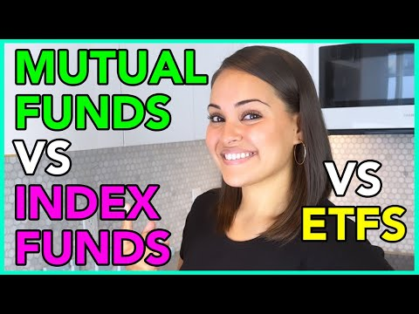
What are Mutual Funds, Index Funds, & ETFs?
3 common types of funds that people can invest in.
Which of the following statements about Mutual Funds is FALSE?
Mutual fund managers that are actively managing try to "beat the market" by picking the stocks they think will perform best.
Actively managed mutual funds have annual fees of about 0.6% - 0.8% on average.
An advantage of investing in mutual funds is that you don't have to pick individual stocks and bonds.
A majority of actively managed mutual funds "beat the market" and are worth the higher fees they charge.

Slide 42
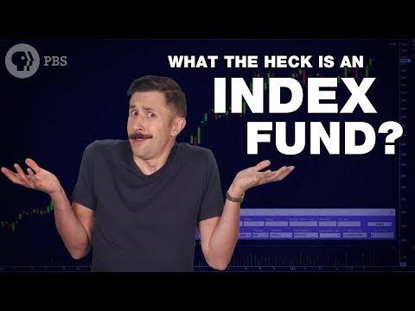
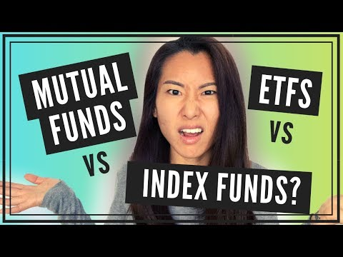
What is an Index Fund?
American Video Canadian Video

Slide 43
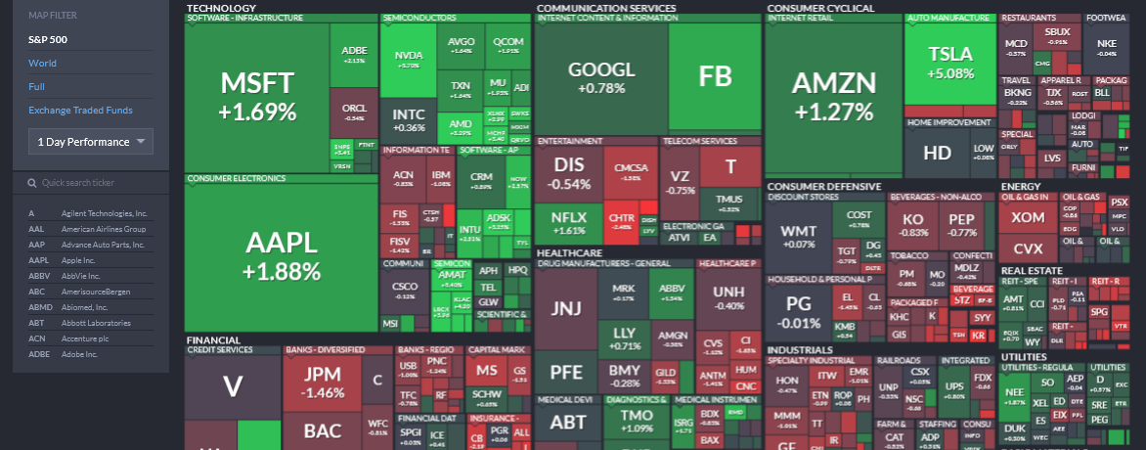
Index Fund S&P 500 https://finviz.com/map.ashx
Notes:
Brighter the GREEN, the bigger the gain On the left, look at the 1 Day Performance. THEN look at the 1 year performance!! Brighter the RED, the bigger the loss

Slide 44
Activity: S&P Interactive
https://docs.google.com/document/d/17r7G2VTMLEtI0zjw111HMfiouL72kIiqSXzvEOlqh3k/edit?usp=sharing

Slide 45
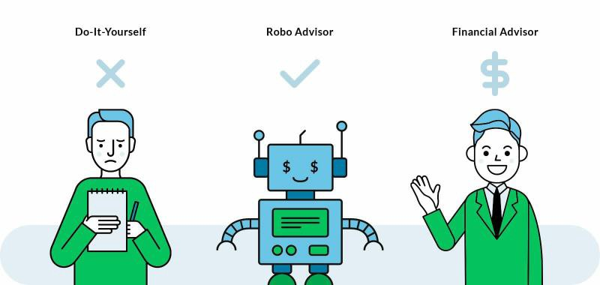
Robo Advisors - Is this a thing?
3 min video:
https://edpuzzle.com/media/5d56c4d1dcda1840bb8d32e2

Slide 46
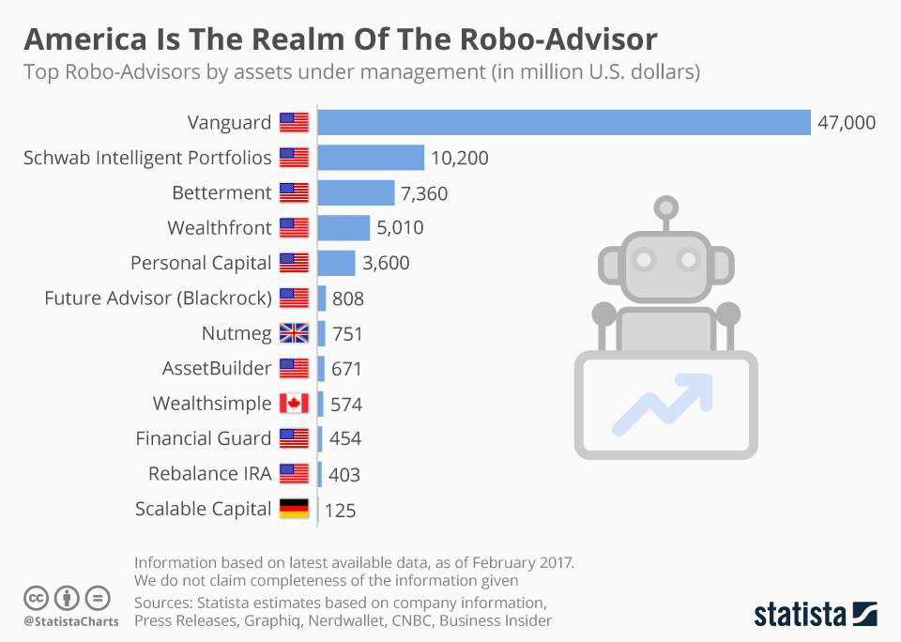
Who uses Robo Advisors?

Slide 47
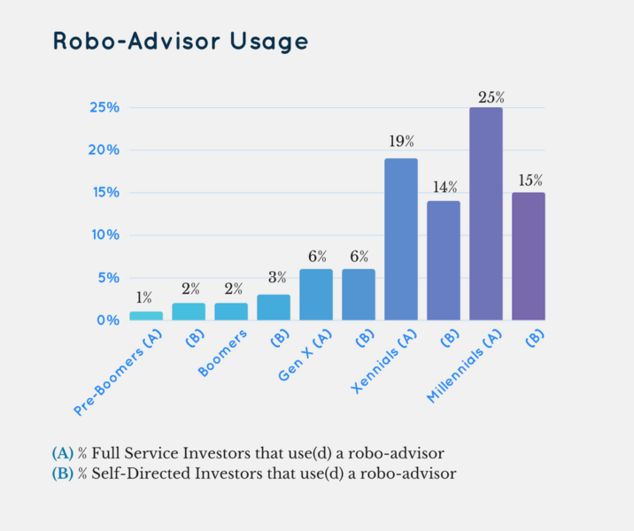
Who uses Robo Advisors?

Slide 48
Top 5 Robo Advisors? (According to Tech Republic)
https://www.techrepublic.com/videos/top-5-investment-robo-advisors/

Slide 49
Exit Ticket
Explain what a robo-advisor is and how it differs from having a human advisor.
Identify one advantage and one disadvantage of using a robo-advisor.
How does a robo-adviser decide how to allocate your investments?

Slide 50
Article - Advice I wish I could give my younger self

Slide 51
S&P 500 & Other Index Funds
Fast Facts
In the 41 years from 1957 to 1998, only 74 of the original 500 companies of the S&P 500 remain (AOL, 2018)
The S&P 500 has increased 2813% since 1979 (Google Finance, 2019)
To get into the S&P 500, companies must meet various criteria, such as having a market capitalization of at least $6.1 billion (this threshold changes over time) and a minimum trading volume of 250,000 shares per month in each of the six months before a stock's evaluation for entry. (Nerd Wallet, 2021)

Slide 52
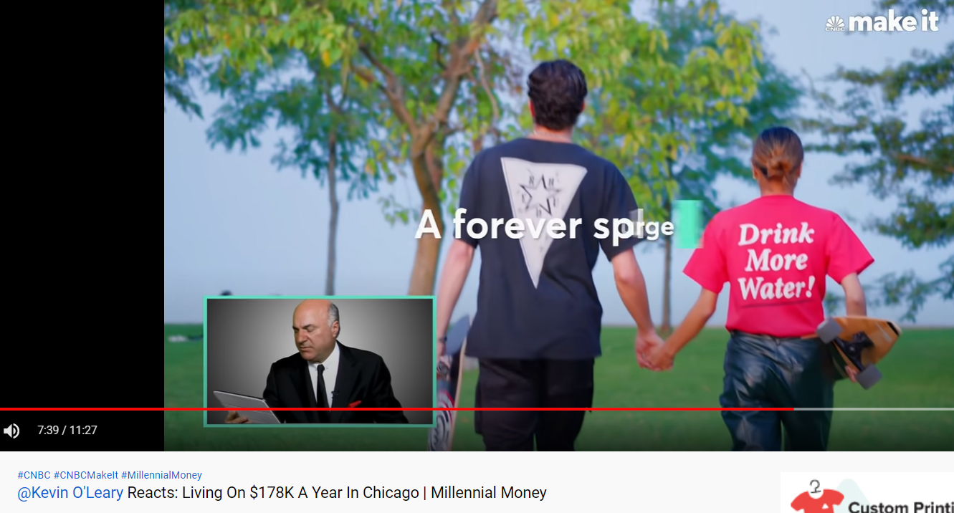
Analysis of a couple living in Chicago Feb 2021
https://youtu.be/DctuVe-JVSs

Slide 53
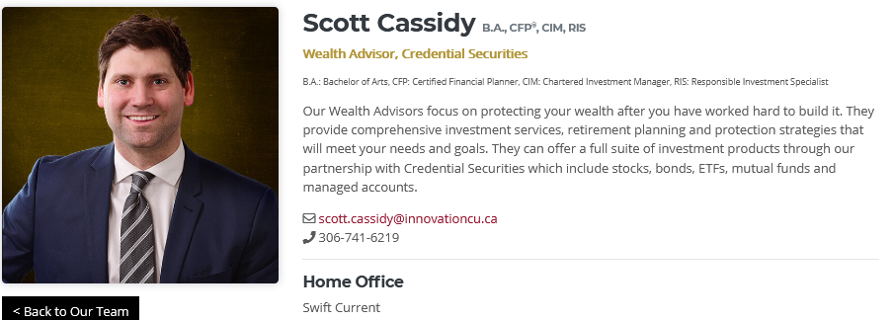
Recorded Guest Speaker (Swift Current)
Want to learn more about saving & investing? Swift Current Financial Guest Speaker Scott Cassidy: What can students invest in? https://drive.google.com/file/d/1rmjhRN1O0BLkWkkAWyxRcrzqowt-g40O/view?usp=sharing

Slide 54
Fun Facts
90% of actively managed funds underperformed passive funds. (Financially SImple 2017)
Active vs Passive Funds: It’s important to note that some funds have higher fees because they are managed by a professional called an investment manager.
0.75% in fees equates to a 20% smaller nest egg in just 30 years. (Financially Simple 2017)
The average fee for a professional financial advisor’s services is 1.02% of assets under management annually for an account of one million dollars (the industry average fee is 0.99% and decreases depending on the size of your account). (Investopedia 2019)

